Slide 1

A Presentation On [Car Price Prediction using Linear Regression Technique of Machine Learning ]
Presented by:
1.Samiksha Badgujar
2.Yashodhan Gupta
3.Sufiyaan Rahi
4.Munawwar Rangila
Guided by:
Mrs. V.C. Sanap
Group ID :1
All India Shri Shivaji Memorial Society’s Polytechnic
Diploma in Computer Engineering (Semester-VI), Kennedy Road, Near RTO, Pune – 411001
Course code : 22060

Slide 2
Outline
Abstract
Introduction
Literature Survey
Architectural Design
Resources required
Experimental results
Publications
Conclusion
References

Slide 3
Abstract
In this fast-moving generation, the present study proposes the newer concept of predicting the prices of certain items. With an idea and motivation to help everyone we came up with a solution to get an appropriate estimate of one’s car using Machine Learning Techniques which will save a lot of time and money. A car price prediction has been a high interest research area, as it requires noticeable effort and knowledge of the field expert. Considerable number of distinct attributes are examined for the reliable and accurate prediction. To build a model for predicting the price of the cars, we applied one of the machine learning techniques i.e., Linear Regression.

Slide 4

Introduction
In our day to day lives everyone buys and sells a car every day.
There e are limited facilities and applications to get an appropriate price for one’s car so need an application to get an estimate value of the car.
Linear regression algorithm for this purpose. This object comprises of Car as an object and the price for every car entered in the dataset. Linear Regression allows us to compare our entered data to the existing data in the dataset and gives us an estimate value for the car.
Car works as a main object. The attributes such as Company Name, Kilometres Driven, Fuel Type and Year of Purchase etc are upon which the comparison is performed using Machine Learning Techniques.
Also, further on discussing the imperatives, we have utilized composite configuration design, which make it well extendable to include or uproot as numerous.

Slide 5
Literature Survey
Researchers more often predict prices of products using some previous data and so did Pudaruth [1] who predicted prices of cars in Mauritius and these cars were new rather second hand. He used multiple linear regression, k-nearest neighbours, naïve Bayes and decision trees algorithm in order to predict the prices.
The comparison of prediction results from these techniques showed that the prices from these methods are closely comparable. However, it was found that decision tree algorithm and naïve bayes method were unable to classify and predict numeric values. Pudaruth’s research also concluded that limited number of instances in data set do not offer high prediction accuracies [1].

Slide 6
Literature Survey cont..
Multivariate regression model helps in classifying and predicting values of numeric format. Kuiper [2] used this model to predict price of 2005 General Motor (GM) cars.
The price prediction of cars does not require any special knowledge so the data available online is enough to predict prices like the data available on www.pakwheels.com. Kuiper [2] did the same i.e. car price prediction and introduced variable selection techniques which helped in finding which variables are more relevant for inclusion in model.

Slide 7
Methodology
We needed some previous data set of pre-owned cars for estimating the car price on the basis of some attributes like price, year of purchase, distance travelled, model etc. These attributes are taken as independent variables whereas the car price is dependent on these variables.
The equation of linear regression which combines our attributes and displays the result is based on:
Y = β0 + β1X
In the above represented equation β0 , β1 represents the regression coefficients,
Y as the output or required variable and X shows the input.
Relation in case of single input is represented by the above equation.
For multiple inputs by the user the given below equation is used.
Y = β0 + β1X1+ β2X2+……. βnXn
There are many attributes and features that impact the price of a car which ultimately generates large sets of data which leads to complexity in analysing it.

Slide 8
Resources Required
Software Specification:
Hardware Specifications:
Sr No. | Resource | Configuration
1. | Operating System | Windows 10
2. | Coding language | Python, R
3. | Software | Jupyter Notebook, Visual Studio & PyCharm
Sr.No | Resource | Configuration
1 | Processor | Intel i5 core
2 | Speed | 3.6 GHz
3 | RAM | 8 GB
4 | Hard Disk | 1 TB

Slide 9
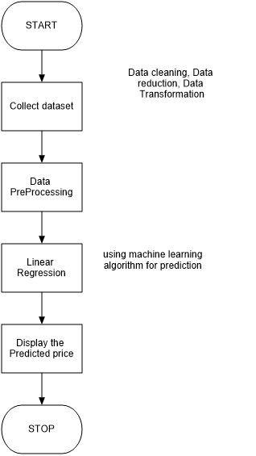
Architectural Design

Slide 10
Experimental Results
The model involves attributes like the car’s company name, model of the car, rc issued which is the year of purchase, fuel type and kilometres driven.
First as shown in the image
The user selects the company of the car he owns. The company names are fetched from the dataset we had provided in the backend for the user to successfully select the company name.
The user then selects the car model of the particular company. The car model is also fetched from the dataset.
Year of Purchase is the year in which the car was purchased.
The fuel type of the car is to be selected.
Kilometres driven Lets the user input how much the car has travelled.
Finally upon clicking on the check price button after successfully filling the attribute fields the estimated car price is displayed which gives the user an idea at which the user can sell the car or lets him determine the value of the car.

Slide 11
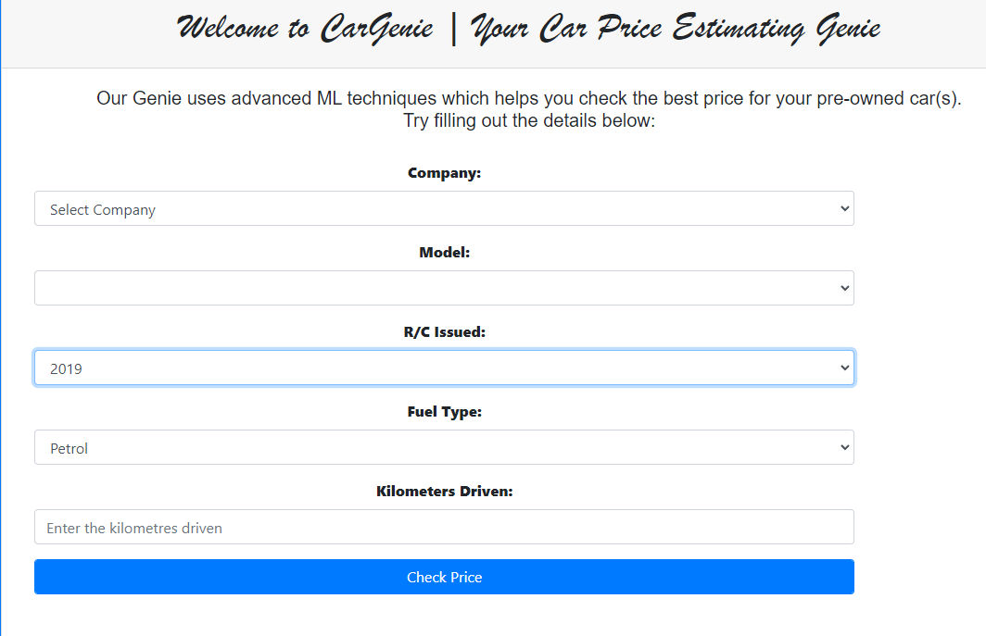
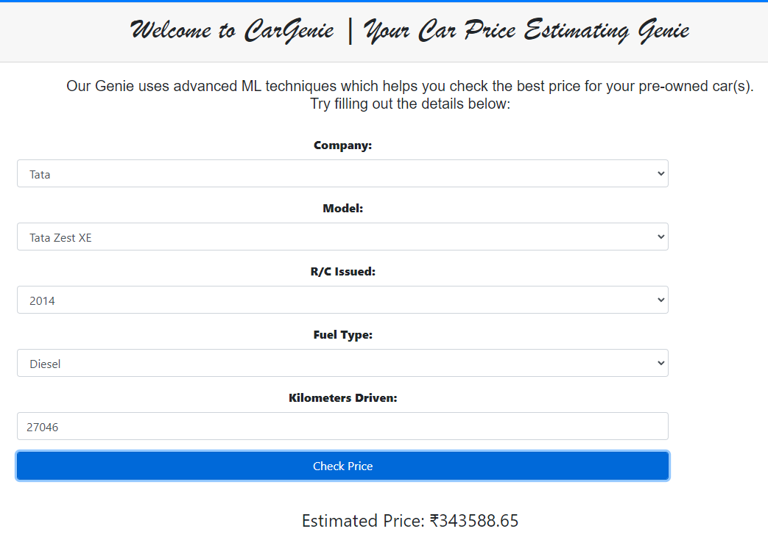
Output

Slide 12
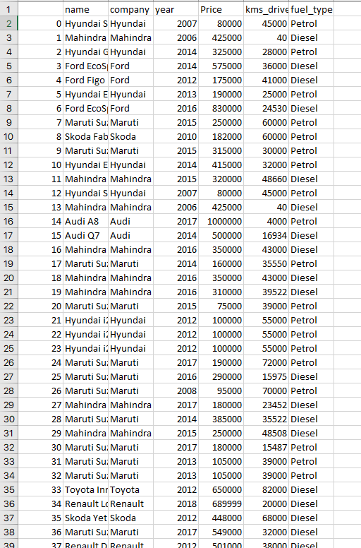
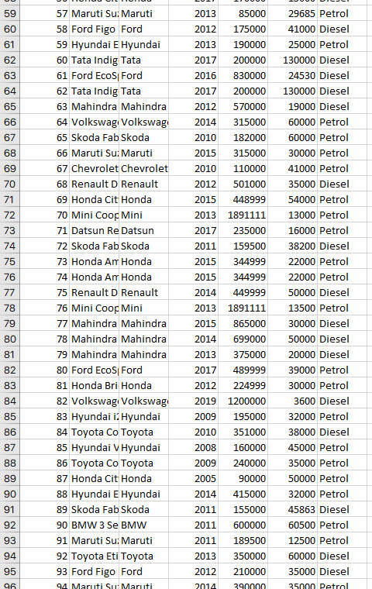
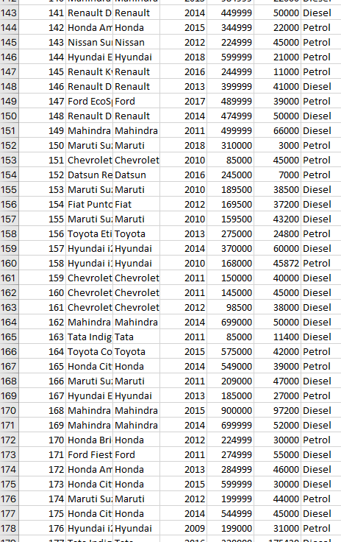
Trained Dataset

Slide 13
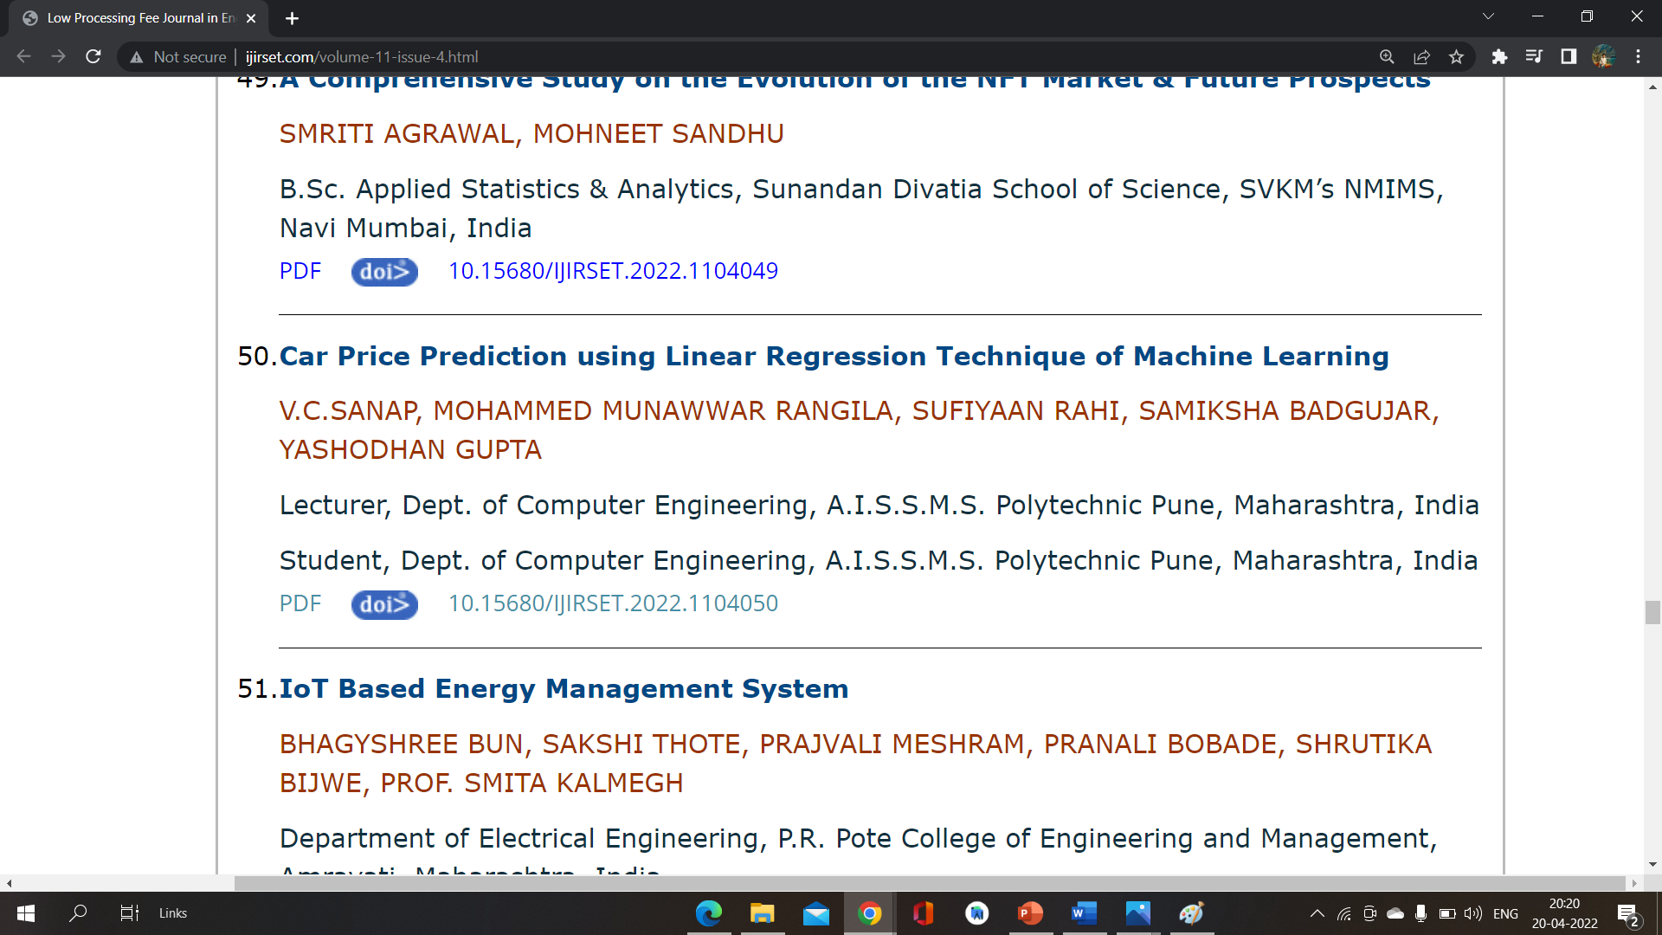
Publications
Our Group has successfully Uploaded implementation Paper
on Following Website
http://www.ijirset.com/volume-11-issue-4.html

Slide 14
After Doing further Process Our Paper was published on “IJIRSET”
(International Journal of Innovative Research in Science, Engineering and Technology)
Journal
The Impact Factor Of Journal is : 8.118
Link Of Our Paper :
http://www.ijirset.com/upload/2022/april/50_Car_NC.pdf

Slide 15

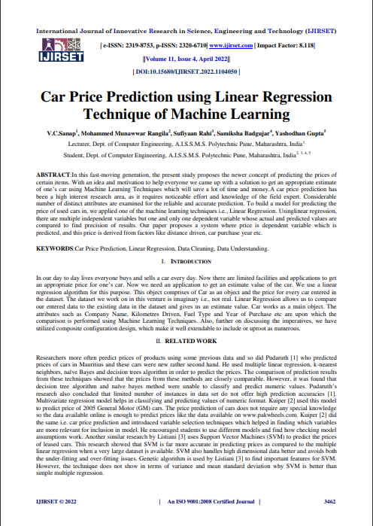
First Two Pages of Paper

Slide 16
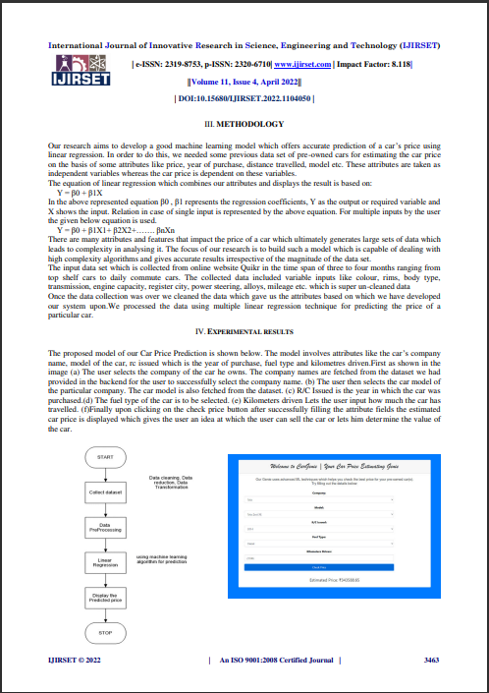
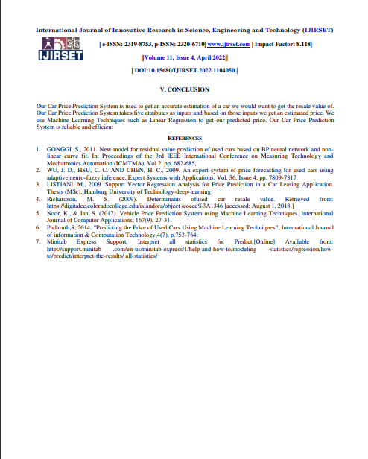
Remaining Pages of Paper

Slide 17
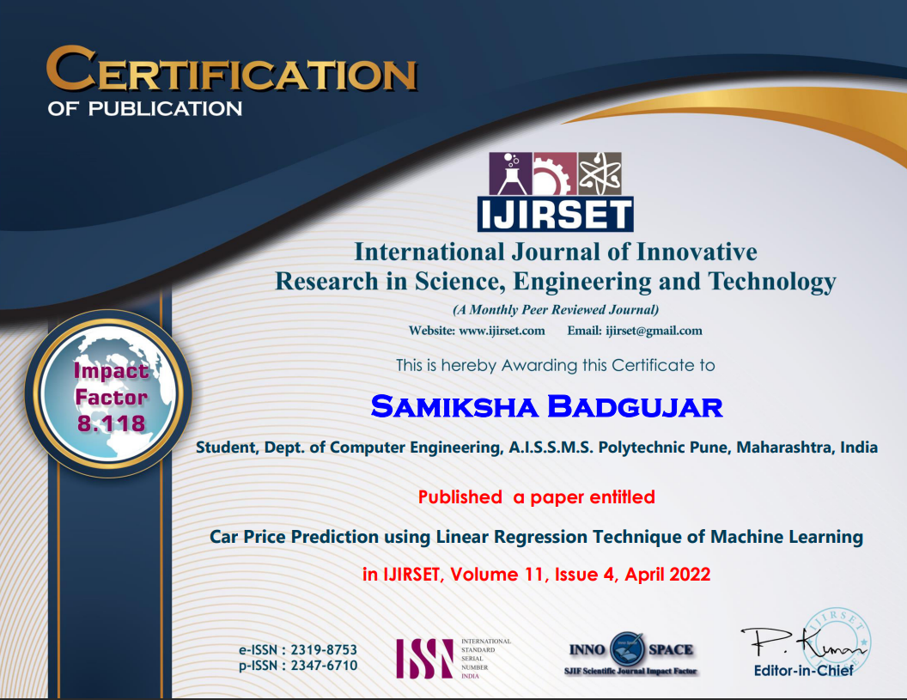

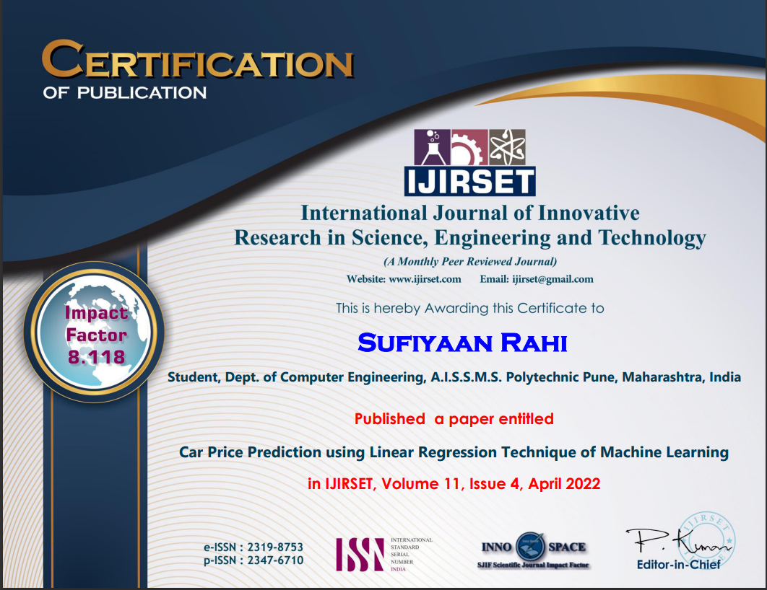
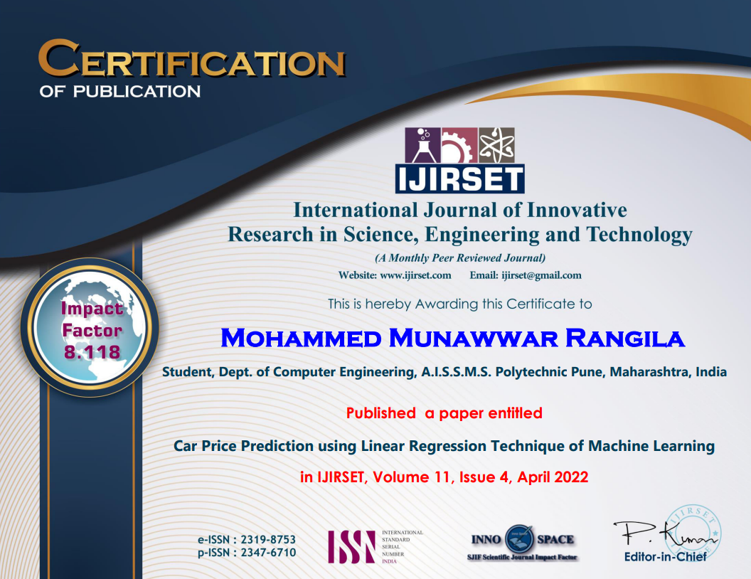

Slide 18
Conclusion
Car Price Prediction System is used to get an accurate estimation of a car we would want to get the resale value of.
Our Car Price Prediction System takes five attributes as inputs and based on those inputs we get an estimated price. We use Machine Learning Techniques such as Linear Regression to get our predicted price.
Our Car Price Prediction System is reliable and efficient.

Slide 19
References
GONGGI, S., 2011. New model for residual value prediction of used cars based on BP neural network and nonlinear curve fit. In: Proceedings of the 3rd IEEE International Conference on Measuring Technology and Mechatronics Automation (ICMTMA), Vol 2. pp. 682-685,
WU, J. D., HSU, C. C. AND CHEN, H. C., 2009. An expert system of price forecasting for used cars using adaptive neuro-fuzzy inference. Expert Systems with Applications. Vol. 36, Issue 4, pp. 7809-7817
LISTIANI, M., 2009. Support Vector Regression Analysis for Price Prediction in a Car Leasing Application. Thesis (MSc). Hamburg University of Technology-deep-learning
Richardson, M. S. (2009). Determinants of used car resale value. Retrieved from: https://digitalcc.coloradocollege.edu/islandora/object /coccc%3A1346 [accessed: August 1, 2018.]
Noor, K., & Jan, S. (2017). Vehicle Price Prediction System using Machine Learning Techniques. International Journal of Computer Applications, 167(9), 27-31.
Pudaruth,S. 2014. “Predicting the Price of Used Cars Using Machine Learning Techniques”, International Journal of information & Computation Technology,4(7), p.753-764.
Minitab Express Support. Interpret all statistics for Predict.[Online] Available from: http://support.minitab .com/en-us/minitab-express/1/help-and-how-to/modeling -statistics/regression/howto/predict/interpret-the-results/ all-statistics/

Slide 20
THANK YOU…!

